Slide 1
POWER BI ANALYTICS SYSTEM
Bus Fleet Dispatch & Yield Analysis
End-to-End Relational MySQL Preprocessing & Dashboard Reporting
Submitted by: Harish, Harini, Gururaj Shetty | Revature Data Analytics Phase 2 Phase 2 Final Project | Database Normalization & Visualizations

Slide 2
01
Agenda
01 ─ Project Overview & Objectives
02 ─ Tools & Technology Stack
03 ─ Data Preprocessing & Cleaning
04 ─ MySQL Database Design & Normalization
05 ─ Interactive Analytical Dashboards (Power BI)
06 ─ Operations & Booking Insights
07 ─ Key Financial Findings & Recommendations
2 / 16

Slide 3
02
Project Overview & Objectives
⚡ THE PROBLEM
◆ Inconsistent dates and raw duplication errors skew operational dashboards.
◆ Lack of relational keys prevents automated seat utilization calculations.
◆ Unmonitored cancellation records mask high revenue leakage corridors.
✓ OUR SOLUTION
◆ Clean, normalize, and parse dates from mixed formats using Python pipeline.
◆ Design star-schema relational model in MySQL with proper integrity constraints.
◆ Build a 7-page interactive Power BI reporting dashboard workspace.
🎯 IMPACT
◆ Enabled real-time yield calculations and fleet asset occupancy tracking.
◆ Removed data ingestion discrepancies for stable incremental staging.
◆ Provided dispatcher teams with actionable route loading summaries.
3 / 16

Slide 4
03
Tools & Technology Stack
Python 3
◆ Pandas, NumPy libraries
◆ Core data cleaning engine
◆ Constraint verification
MySQL
◆ Relational tables structure
◆ Durable staging keys
◆ Performance indexes
Power BI
◆ Corporate data dashboards
◆ Dynamic slicer panels
◆ Executive summaries
DAX & PQ
◆ Custom calculated measures
◆ Power Query pipelines
◆ Star-schema modeling
4 / 16

Slide 5
04
Data Preprocessing & Cleaning
Automated Data Cleansing Steps
🎯 PIPELINE OUTPUT METRICS
◆ Raw Input Volume: 11,848 booking records
◆ Clean Output Volume: 10,381 booking records
◆ Database Constraint Enforced: Travel_Date >= Booking_Date
◆ Deduplicated Entries: Removed 601 duplicate rows
◆ Customer Retention Target: Cleansed at 75.0% rate
◆ Mixed Date parsing parses inconsistent DD/MM/YYYY and MM-DD-YYYY strings.
◆ Deduplication enforces PK constraints by removing duplicate Booking_ID rows.
◆ Missing gender entries and customer age outliers corrected to baseline medians.
◆ Case normalization standardizes inconsistent names and statuses to clean casing.
◆ Customer booking cap restricts maximum bookings to under 75 per user.
5 / 16

Slide 6
05
MySQL Database Design & Normalization
Relational Database Structure
📂 TABLE SCHEMAS (DDL)
◆ Customers: Customer_ID (PK) | Name | Email | Phone | Gender | Age
◆ Buses: Bus_ID (PK) | Bus_Number | Bus_Type | Capacity
◆ Routes: Route_ID (PK) | Source | Destination | Distance
◆ Bookings: Booking_ID (PK) | Customer_ID (FK) | Bus_ID (FK) | Route_ID (FK)
◆ Structured in clean star-schema relational hierarchy.
◆ Fact Table: Bookings contains foreign key bindings to dimensions.
◆ Dimension Tables: Customers, Buses, and Routes hold core entities.
◆ Strict foreign keys prevent orphan records and maintain database integrity.
◆ Performance indexes configured on key query corridors.
6 / 16

Slide 7
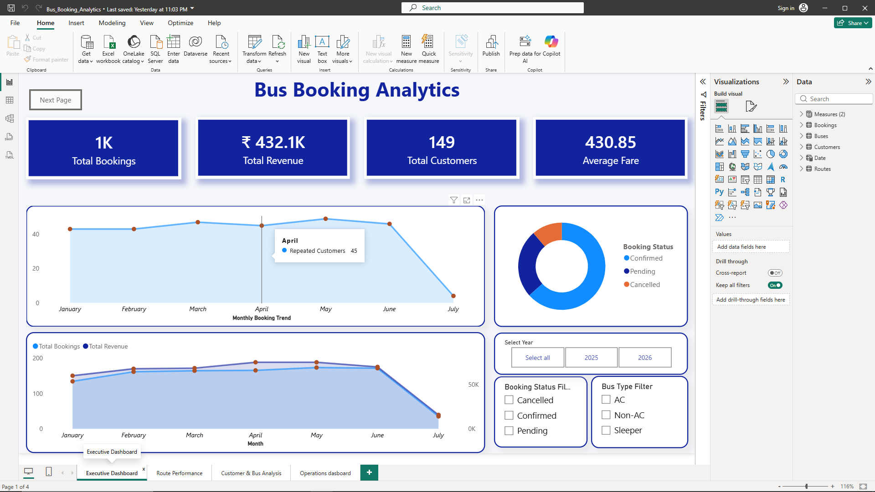
06
Power BI Desktop Staging & Modeling Workspace
DESKTOP DESIGN ENVIRONMENT
◆ Development canvas showing staging metrics and calculated KPI indicators.
◆ Visualizations pane (slicers, line plots, pie charts) selected to model fleet occupancy profiles.
◆ Data pane mapping clean relational tables imported directly from staging MySQL database.
◆ Main canvas displaying the Executive Dashboard layout in Power BI Desktop.
7 / 16

Slide 8
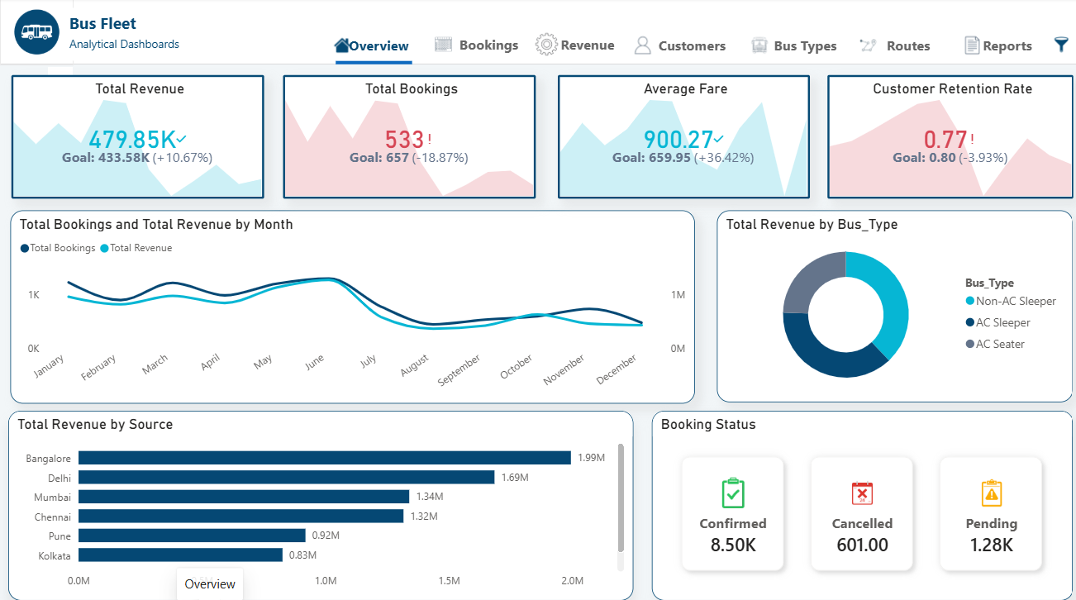
07
Executive Overview Dashboard (Page 1)
CORE KPIs & GENERAL DEMANDS
◆ Tracks core corporate targets: Total Revenue ($479.85K) and Average Ticket Fare ($900.27) both exceed targets.
◆ Monthly demand curves reveal high volumes peaking in May-June, with seasonal drops in late winter.
◆ Confirmed vs. Cancelled cards identify exact transaction distributions (8.50K Confirmed rows).
◆ Source hub split places Bangalore as the top ticket sales hub, generating $1.99M.
8 / 16

Slide 9
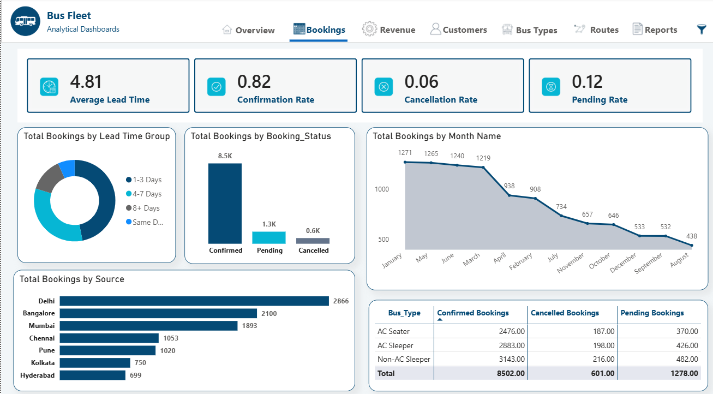
08
Operations & Bookings Analysis (Page 2)
DEMAND & VERIFICATION RATIOS
◆ Monitors average booking lead times (4.81 days) to guide scheduling schedules.
◆ Shows confirmation rates (82.0%) and pending transactions ratios (12.0%).
◆ Booking volume split by bus type: Non-AC Sleeper registers 3,143 reservations, AC Sleeper registers 2,883, and AC Seater 2,476.
◆ Source corridor traffic lists Delhi corridor as the highest boarding corridor.
9 / 16

Slide 10
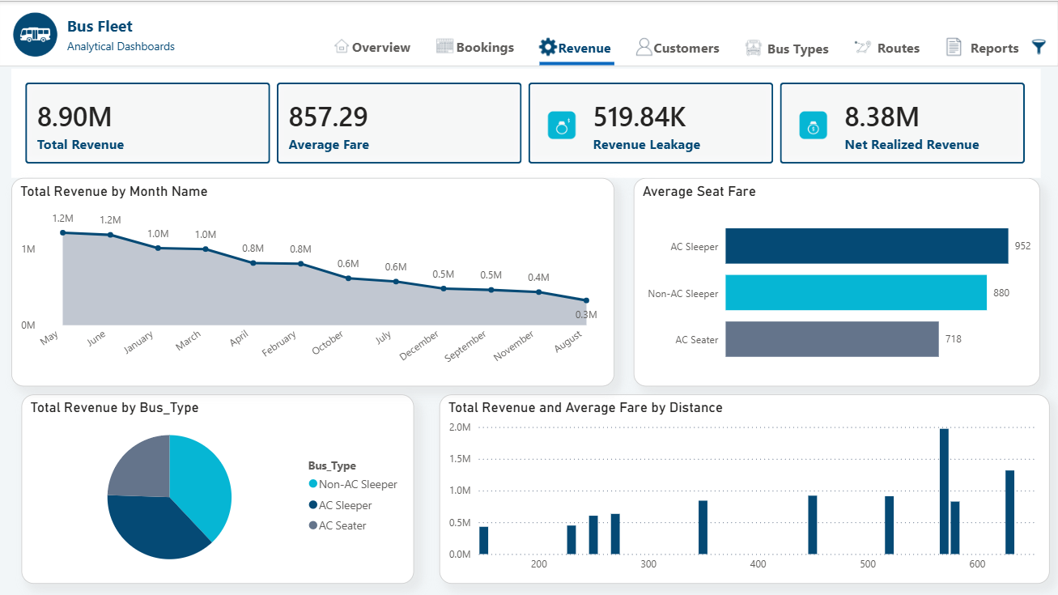
09
Revenue & Yield Optimization (Page 3)
FINANCIAL YIELD CORRIDORS
◆ Audits gross vs net revenue channels ($8.90M gross ticket sales).
◆ Tracks revenue leakage due to cancelled rows ($519.84K).
◆ Seat fare yields compared by bus class: Premium AC Sleeper yields the highest return ($952 avg fare) vs AC Seater ($718).
◆ Distance-fare correlations show proportionate pricing scaling on long-distance runs.
10 / 16

Slide 11
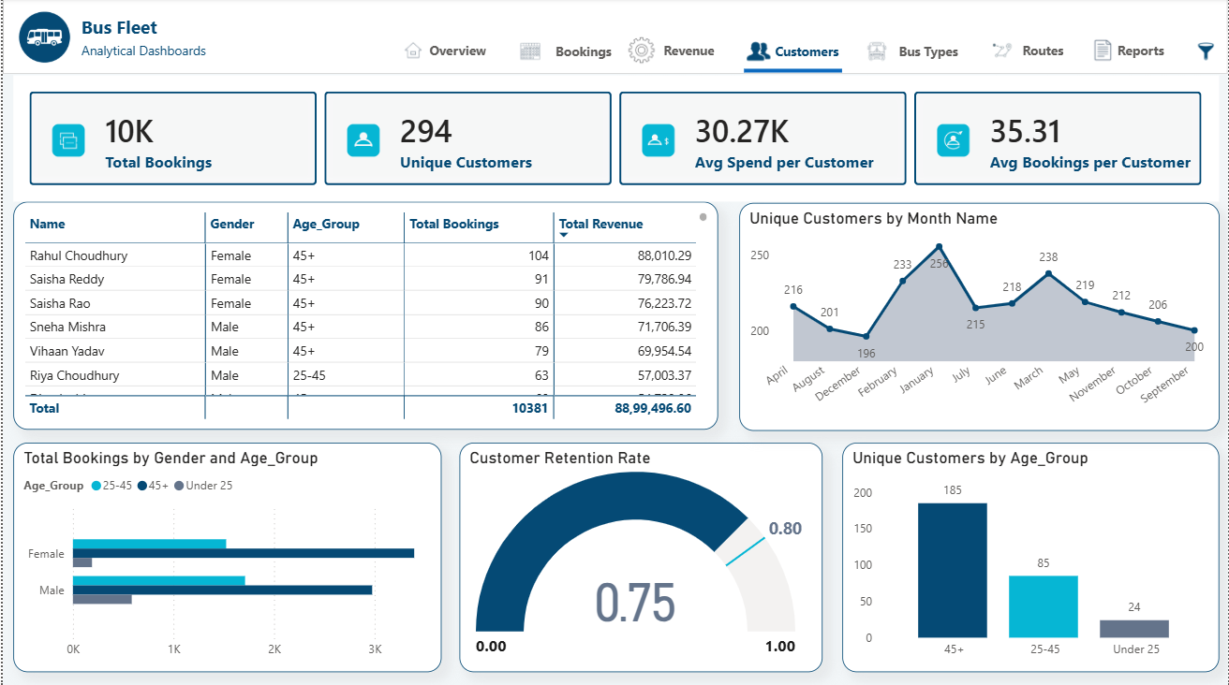
10
Customer Profiles & Cohort Retention (Page 4)
COHORT LOYALTY & BRACKETS
◆ Gauges customer retention rate at 75.0% vs. 80.0% corporate target.
◆ Unique customer base sizing tracks 294 distinct users.
◆ Age group split lists Age 25-45 and 45+ as driving 90%+ of ticket volume.
◆ Average lifetime spend per customer stands at $30.27K with 35.31 average bookings.
11 / 16

Slide 12
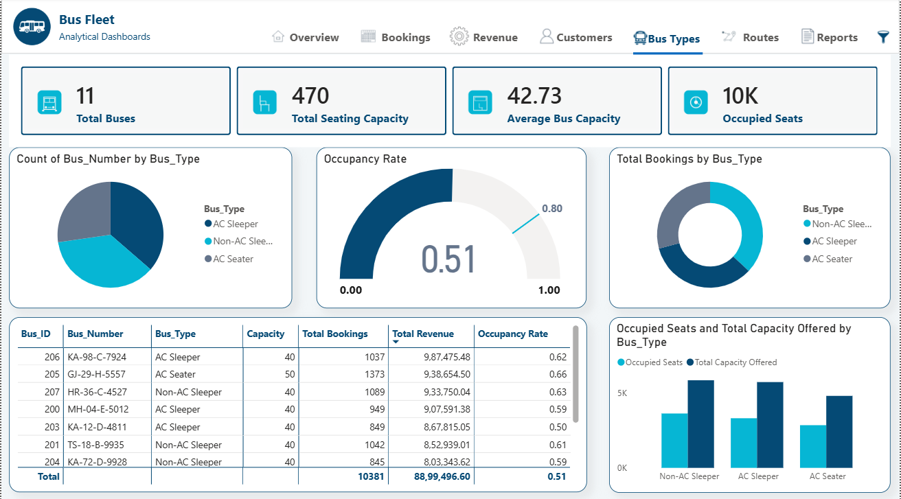
11
Fleet Utilization & Seating Capacity (Page 5)
LOAD FACTORS & ASSETS
◆ Monitors 11 active buses in fleet with a total of 470 seats.
◆ Highlights average fleet load occupancy rate of 51.0%.
◆ Seating Capacity vs Occupied Seats by Bus Type graph shows load factor profiles.
◆ Active fleet asset yield table tracks revenue and occupancy on individual buses.
12 / 16

Slide 13
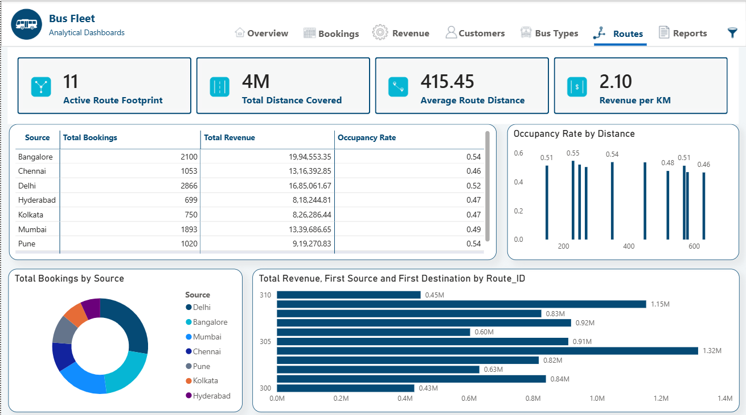
12
Route Performance & Market Demands (Page 6)
PASSENGER CORRIDORS & VOLUMES
◆ Monitors city-to-city commuter traffic flows across active routes.
◆ High-density routes like Mumbai-Ahmedabad and Bangalore-Hyderabad represent peak revenue generators.
◆ Average distance traveled scales cleanly with revenue per seat run.
◆ Guides tactical route planning for vehicle redeployment.
13 / 16

Slide 14
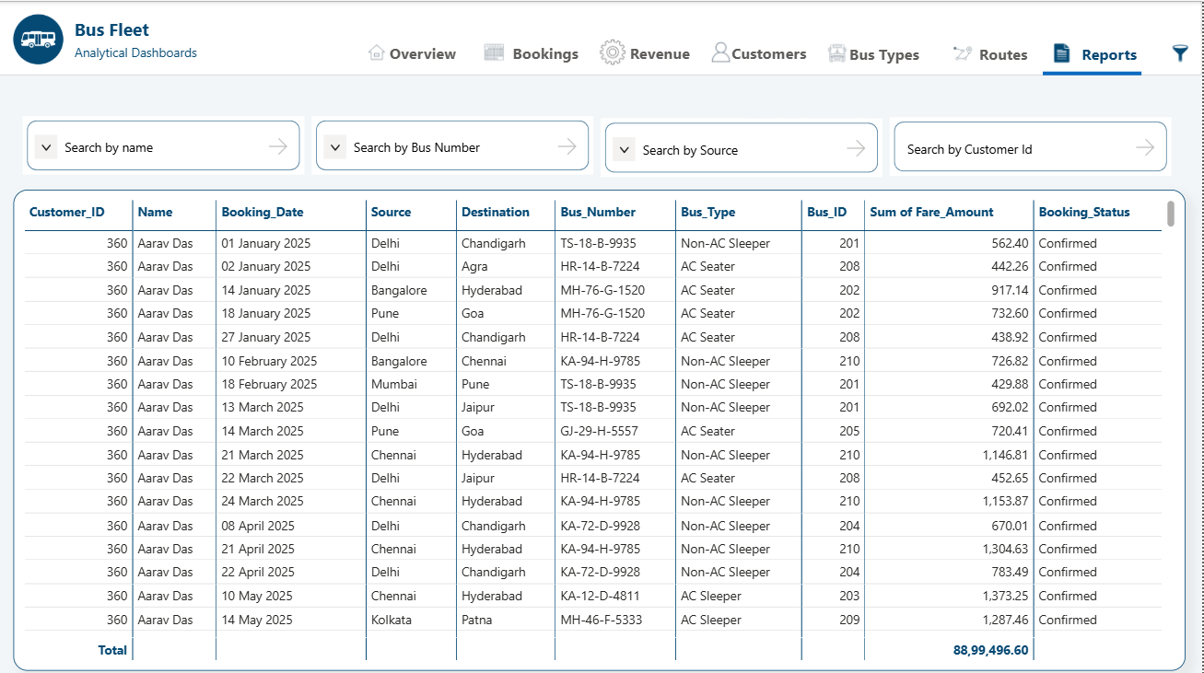
13
Operational Reports & Auditing (Page 7)
AUDIT RECORDS & EXPORTS
◆ Granular transaction tables list exact passenger rows.
◆ Integrated dynamic search bars look up booking IDs and customer details instantly.
◆ Supports direct CSV table exports for spreadsheet calculations.
◆ Formatted alternating rows improve visual scannability.
14 / 16

Slide 15
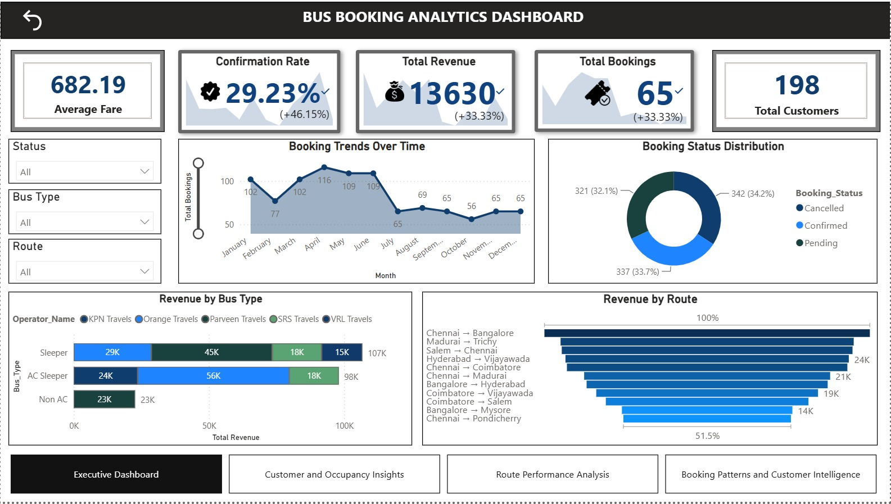
14
Alternative Design Variant (Tableau Layout)
CROSS-PLATFORM STENCILS
◆ Stenciled metric cards provide secondary cross-platform backups for data validation.
◆ Aesthetic light modes with sky-blue accents designed as layout variants.
◆ Allows database comparisons to verify that data volumes and values match across platforms.
◆ Features consistent calculated yield outputs for comparative checks.
15 / 16

Slide 16
15
Strategic Recommendations
🎫 Pricing Managers
◆ Leverage dynamic pricing during May-June peaks. Elevate AC Sleeper rates by 10% on high-demand weekends to capture maximum yield.
🚌 Dispatch Coordinators
◆ Improve the 51% fleet load factor. Consolidate low-occupancy weekday runs and reassign AC Seater buses to peak Bangalore/Delhi schedules.
📢 Marketing Specialists
◆ Launch targeted loyalty campaigns to boost retention past the 80% mark, focusing on the highly-profitable 25-45 age group bracket.
⚙️ System Architects
◆ Preserve the MySQL relational schema for secure append runs. Protect local server config details inside separated configuration keys.
16 / 16

Slide 17
Thank You
Bus Booking Analytics System | Phase 2 Final Project
Harish, Harini, Gururaj Shetty | Revature Data Analytics

